Slide 1
BIKE SHARING RENTALS
GROUP - 1

Slide 2
Agenda
1. Mentor & Team Details
2. Problem Statement
3. Objective
4. Dataset Overview
5. Project Milestones
6. EDA Overview
7. Target Variable Analysis
8. Season & Weather Impact
9. Working Day & User Behaviour
10. Numeric Feature Analysis
11. Correlation Analysis
12. Feature Engineering
13. Modelling Approach
14. Baseline Models
15. Final Model Selection
16. Hyperparameter Tuning
17. Model Evaluation
18. Results & Insights
19. Application Screenshot - 1
20. Application Screenshot - 2
21. Application Screenshot - 3
22. Challenges Faced
23. Conclusion
24. Future Scope
25. Thank You

Slide 3
Mentor & Team Details
Mentors
Team Members
Geethika
Prajwal
Chanakya Dhiman
CH Krishna Mohith
Ankita Bairagi
Abinav EV
Adhwaith S
Dabbara Chindu
Sargu Sai Taruni

Slide 4
Problem Statement
The business problem is to ensure a stable supply of rental bikes in urban cities by predicting the demand for bikes.
By providing a stable supply of rental bikes, the system can enhance mobility comfort for the public and reduce waiting time, leading to greater customer satisfaction and accurately predicting bike demand can help bike sharing companies optimize operations including bike availability, pricing, strategies, and marketing efforts by considering demand Based on various external factors such as weather, season, holiday etc..,

Slide 5
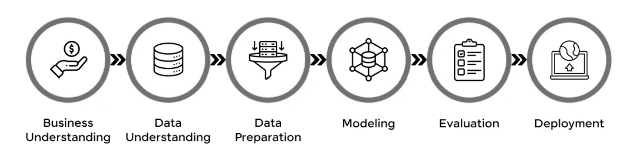
Objective
The objective of this project is to develop a predictive system that accurately forecasts bike rental demand in urban cities using historical data and external influencing factors such as weather conditions, seasons, and holidays.
By predicting demand in advance, the system aims to support bike-sharing companies in ensuring a stable and sufficient supply of rental bikes, thereby reducing customer waiting time and improving overall user satisfaction.
Additionally, the model will assist in optimizing operational decisions related to bike distribution, pricing strategies, and marketing planning based on expected demand patterns.
Image Source: https://www.guvi.in/blog/guide-for-data-science-process/

Slide 6
Dataset Overview
Sr.No | Column Name | Column Description
1 | Instant | Index number
2 | Dteday | Date (Format: YYYY-MM-DD)
3 | Season | Season Name
4 | Yr | Year
5 | Month | Month (1-12)(Jan-Dec)
6 | Hr | Hour(0 to 23)
7 | Holiday | Whether the holiday is there or not
8 | Weekday | Day of the week
9 | Workingday | Whether it is a working day or not
10 | Weathersit | Weather situation
11 | Temp | Normalized temperature in Celsius
12 | Atemp | Normalized feeling temperature
13 | Hum | Normalized humidity. The Values are divided by 100
14 | Windspeed | Normalized Wind speed. Values are divided by 67
15 | Casual | Count of casual users
16 | Registered | Number of registered users
17 | Cnt | Count of total rental biked including both casual and registered
Target

Slide 7
Project Milestones
30 days to complete the Project:
Milestone | Duration | Task start - End Date
Kick-off and Business Objective discussion | 1 day | 31-Dec-2025
Dataset Discussion & Doubt clarification | 4 days | 05-Jan-2026
EDA | 1 Week | 12-Jan-2026
Model Building and Model Evaluation | 1 Week | 19-Jan-2026
Deployment | 1 Week | 26-Jan-2026
Final presentation | 1 Week | 02-Feb-2026
All
project milestones met on time

Slide 8
EDA Overview
Conducted EDA to understand overall data structure and quality
Analyzed patterns across time, weather, and user behavior
Identified trends, seasonality, and demand fluctuations
Detected influential variables impacting bike rentals
EDA findings guided feature selection and model choice
EDA ensured data-driven decisions before model implementation

Slide 9
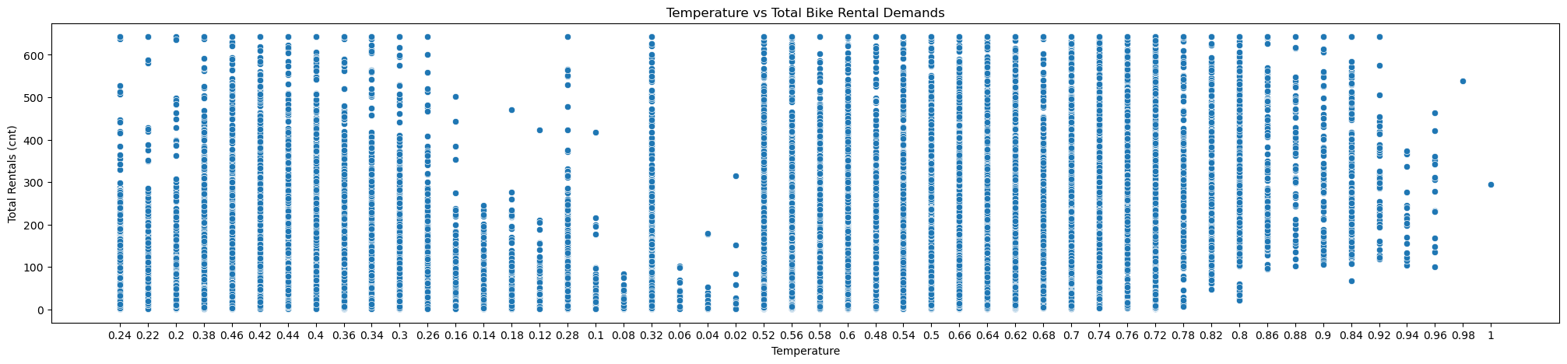
Target Variable Analysis
Bike rental count shows significant variability across observations
Demand distribution highlights peak and off-peak rental periods
Presence of skewness indicates uneven usage patterns
Extreme rental values occur under specific favorable conditions
Confirms suitability for regression-based modeling
Understanding demand distribution supports metric selection and modeling strategy
Inference: Bike rental demand shows clear variability and temporal patterns

Slide 10
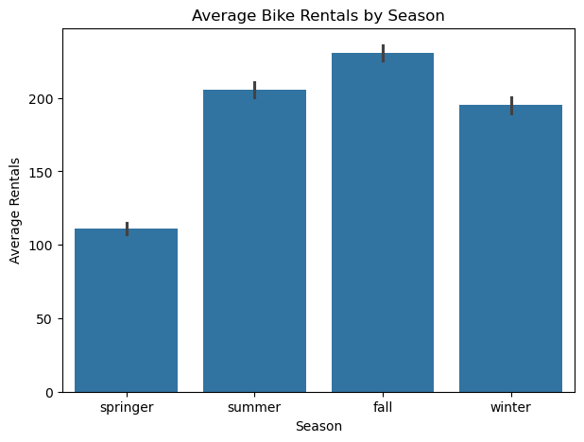
Seasonal & Weather Impact Analysis
Rental demand varies noticeably across different seasons
Favorable weather conditions result in higher rental counts
Extreme weather leads to reduced bike usage
Seasonal trends reflect real-world commuting and leisure behavior
Weather features contribute significantly to demand prediction
Seasonal insights help anticipate demand changes throughout the year

Slide 11
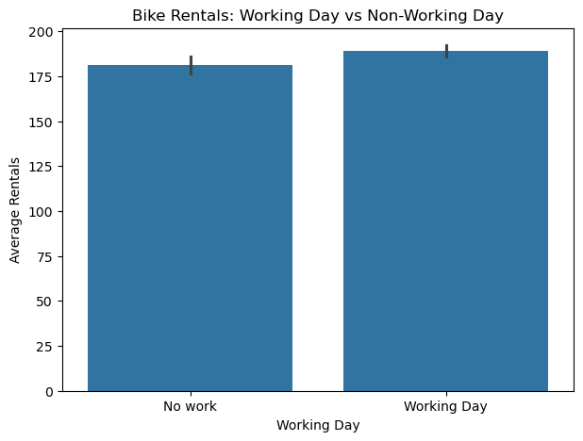
Working Day & User Behaviour Analysis
Rental patterns differ between working days and holidays
Working days show consistent commuter-driven demand
Non-working days exhibit leisure-oriented rental behavior
User behavior changes based on day type
Day-related features enhance model interpretability
User behavior analysis distinguishes routine and recreational usage
patterns

Slide 12
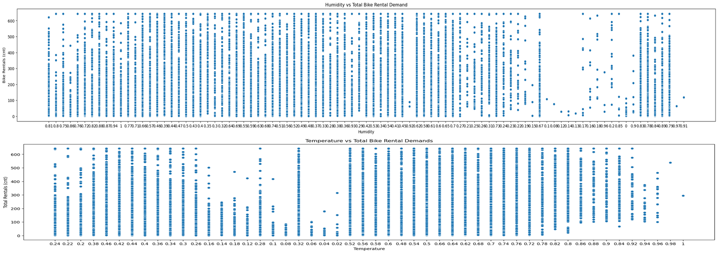
Numerical Feature Analysis
Temperature shows a positive relationship with rental demand
Extremely high or low temperatures reduce bike usage
Higher humidity negatively impacts bike rentals
Wind speed influences rider comfort and demand levels
Relationships observed are largely non-linear
Numerical features strongly affect short-term rental fluctuations

Slide 13
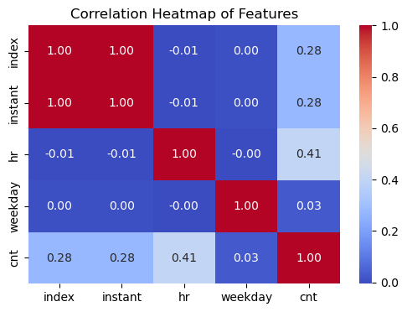
Correlation Analysis
Correlation analysis identifies relationships among features
Weather variables show strong association with bike rentals
No severe multicollinearity detected among predictors
Correlation results support stable model training
Helps in selecting relevant features for modeling
Correlation insights increase confidence in feature relevance

Slide 14

Feature Engineering
Converted categorical variables into suitable numerical formats
Handled missing and inconsistent data values
Prepared clean and structured data for modeling
Ensured features were suitable for machine learning algorithms
Improved overall data quality and reliability
Effective preprocessing enhanced model readiness and performance
Image Source: https://serokell.io/blog/feature-engineering-for-machine-learning

Slide 15

Modelling Approach
Prepared clean dataset after handling missing values & encoding categories
Split data into train–test sets for unbiased evaluation
Tried multiple regression algorithms to compare performance
Established baseline models to set reference metrics
Applied hyperparameter tuning to optimize model performance
Evaluated models using MAE, MSE, RMSE & R²
Selected the best-performing model for final deployment
Image Source: https://velvetech.com/blog/data-modeling-techniques/

Slide 16

Baseline Models
Linear Regression
Simple, fast benchmark model
Helps understand linear relationships
Decision Tree Regressor
Captures non-linear patterns
Useful to compare against more advanced models
KNN Regressor
Distance-based prediction for comparison
Random Forest Regressor (Initial Run)
Strong ensemble baseline to check variance reduction
Image Source: https://medium.com/

Slide 17

Final Model Selection
Final Selected Model → Random Forest Regressor
Reasons:
Lowest error metrics compared to all other models
Handles non-linearity and feature interactions effectively
Robust to noise, outliers, and overfitting
Consistent performance across validation sets
Image Source: https://www.analytixlabs.co.in/blog/random-forest-regression/

Slide 18
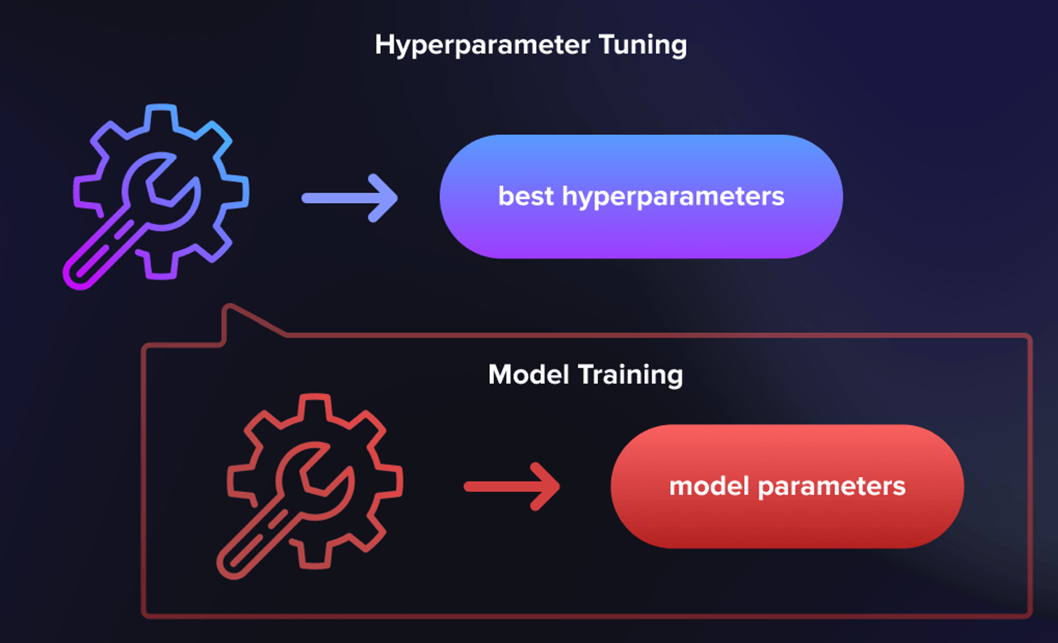
Hyperparameter Tuning
Tuned Parameters Included:
n_estimators (number of trees)
max_depth
min_samples_split
min_samples_leaf
max_features
Approach Used:
GridSearchCV / RandomizedSearchCV for systematic optimization
5-fold cross-validation for stable metric estimation
Selected parameter set giving best trade-off between accuracy & complexity
Image Source: https://serokell.io/blog/hyperparameter-tuning-in-ml

Slide 19
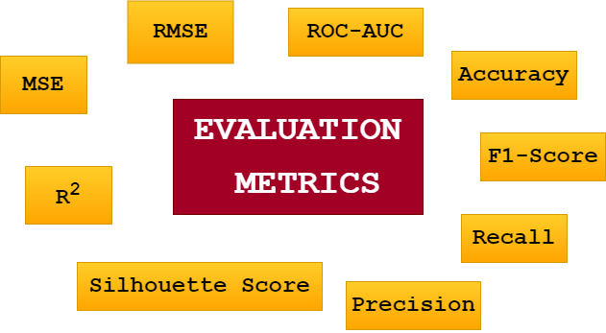
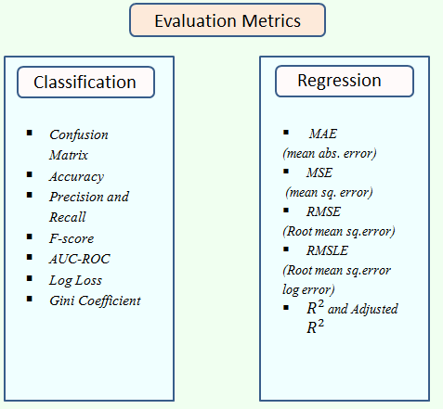
Model Evaluation
Metrics Evaluated:
MAE – Measures average absolute error
MSE – Penalizes larger errors
RMSE – Root error for interpretability
R² Score – Variance explained by model
Observations:
Random Forest achieved highest R² and lowest RMSE among all models
Model performed well across different time/weather conditions
Errors decreased significantly after tuning
Final model generalizes well without overfitting
Image Source: https://www.linkedin.com/pulse/evaluation-metrics-machine-learning-how-measure-model-amina-javaid-2btbf/
Image Source: https://www.linkedin.com/pulse/ml-evaluation-metrices-monika-mittal--a4qhc/

Slide 20

Results & Insights
Successfully developed a bike rental demand prediction model using historical data and external factors such as weather, season, holidays, and time.
Random Forest Regressor was selected as the final model due to:
Lowest error metrics (MAE, RMSE)
Highest R² score compared to other baseline models
Strong ability to capture non-linear relationships and feature interactions
Exploratory Data Analysis (EDA) revealed:
Strong seasonality and hourly demand patterns
Higher demand during favorable weather conditions
Clear differences in usage between working days and holidays
Key demand drivers identified:
Temperature and perceived temperature (positive impact)
Humidity and wind speed (negative impact at extreme levels)
Season, hour of the day, and weekday
Developed an interactive Streamlit web application that:
Allows users to input real-time conditions using sliders and dropdowns
Predicts bike demand instantly
Displays interactive visualizations (monthly, hourly, weekday trends)
The solution supports data-driven operational planning, improving bike availability and reducing customer waiting time.
Image Source: https://sivoinsights.com/get-consumer-insights/

Slide 21
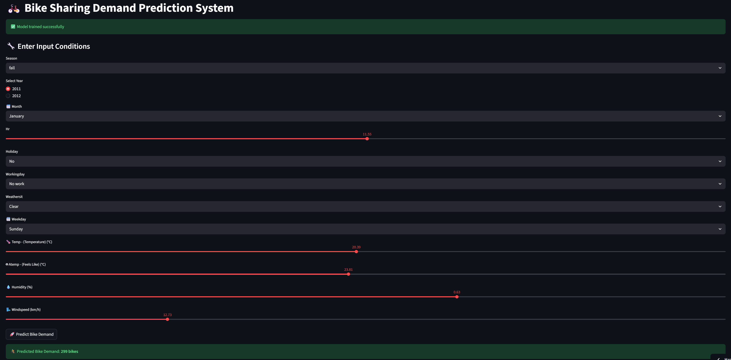
Application Screenshot - 1
https://bike-sharing-demand-prediction-eazmfhbfwa5eweyw8hrxah.streamlit.app/

Slide 22
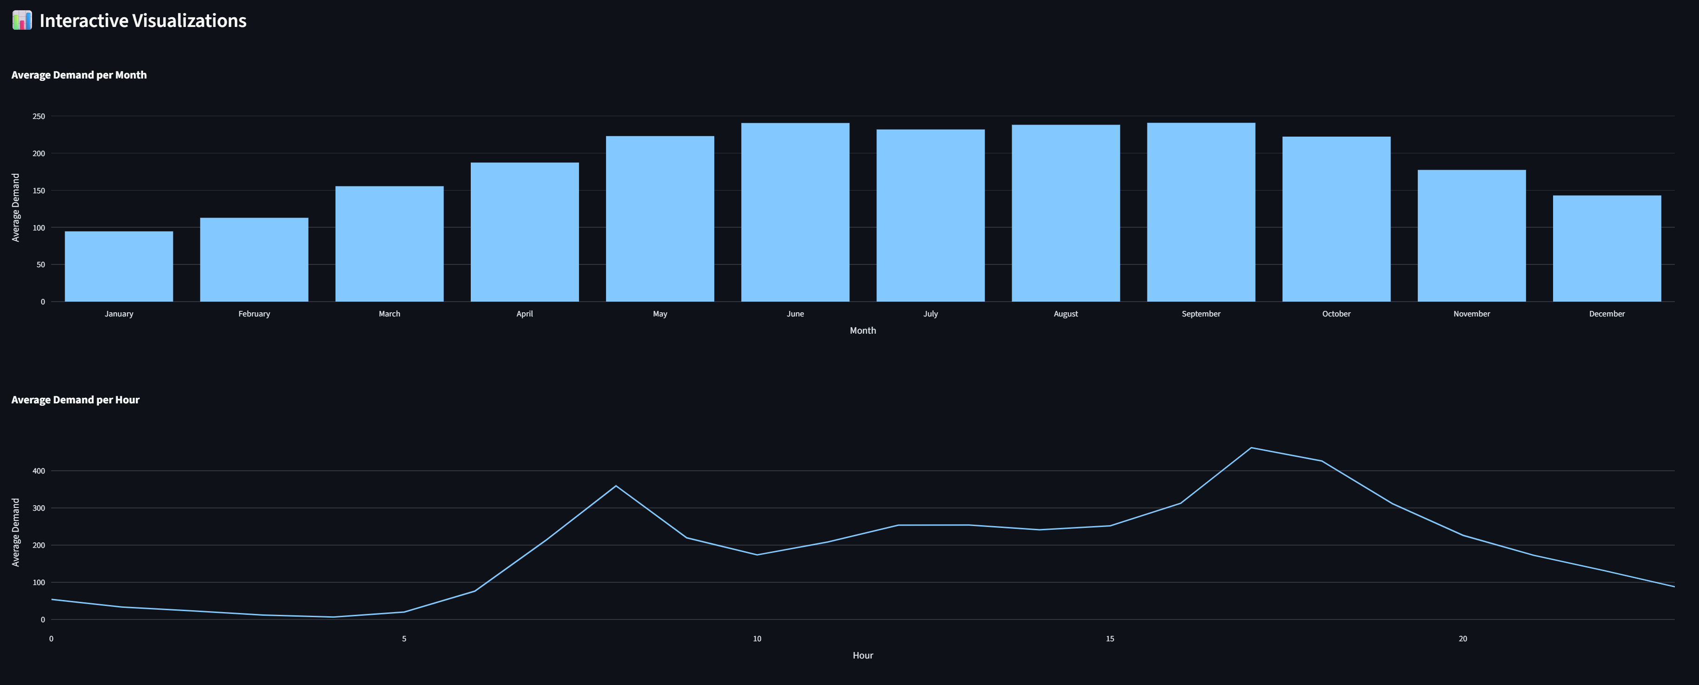
Application Screenshot - 2

Slide 23
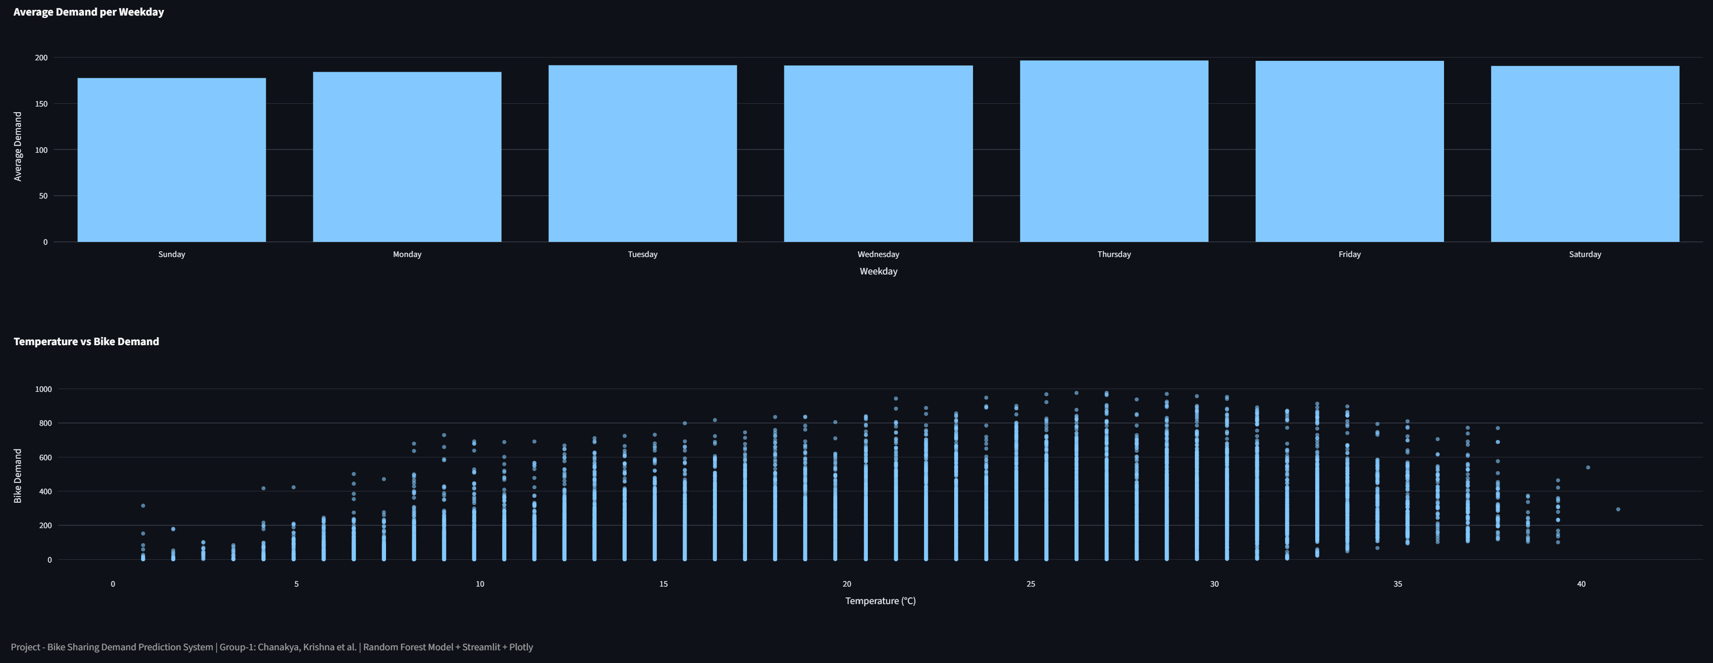
Application Screenshot - 3

Slide 24

Challenges Faced
Data quality issues such as missing values, inconsistent formats, and special characters (?) required extensive preprocessing.
Handling categorical variables (season, weather, holidays) and ensuring correct encoding for both model training and Streamlit inputs.
Managing normalized features in the dataset and converting them back to real-world scales for better interpretability.
Preventing NaN values and incorrect dropdown ordering in the Streamlit app (e.g., month and season issues).
Ensuring feature consistency between training data and user input during real-time prediction.
Balancing model complexity and performance to avoid overfitting while maintaining high accuracy.
Deployment-related issues such as dataset loading errors and Streamlit compatibility constraints.
Image Source: https://www.spacetalent.org/resources/top-6-challenges-faced-by-entrepreneurs

Slide 25

Conclusion
Conclusion:
The project successfully achieved its objective of accurately predicting bike rental demand using machine learning
The Random Forest model demonstrated strong predictive performance and generalization ability
Integration with a Streamlit application transformed the model into a practical decision-support tool
The solution helps bike-sharing companies optimize bike distribution, improve customer satisfaction, and support strategic planning
Image Source: https://www.shutterstock.com/image-illustration/conclusion-isolated-on-special-blue-banner-1151283452

Slide 26

Future Scope
Future Scope:
Incorporate real-time weather and traffic data for more accurate and dynamic predictions
Extend the model to location-based predictions (station-wise demand forecasting)
Experiment with advanced models such as XGBoost, LightGBM, or deep learning approaches
Add automated model retraining and monitoring for long-term deployment
Integrate pricing optimization and recommendation systems based on predicted demand
Deploy the application on a cloud platform for real-world operational use
Image Source: https://www.presentermedia.com/powerpoint-clipart/horizon-scope-pid-8919

Slide 27

THANK YOU

